Slide 1

AI Quiz Generator
User Manual
Author: Visshwa Balasubramanian
Notes:
Preworks course home assignments

Slide 2
Table of Contents
Acknowledgements
About Me
Internship Journey
About the app
How to use the app
Contact person

Slide 3
Acknowledgements
Thank you to Mrs. Mani for helping me through the planning and coding process of the app.
Thank you to Clevered for this opportunity to create this product!

Slide 4
About Me..
Student’s Photograph
Name: Visshwa Balasubramanian
Age: 17
Grade: 11th
Hobbies: Chess, Drawing, Basketball, and Programming
Favorite food: Pizza

Slide 5
About My Internship Journey with Clevered..
Any photographs from sessions etc.
My internship Journey with Clevered was very smooth and I had a great time learning how to create an app and deploy it!

Slide 6
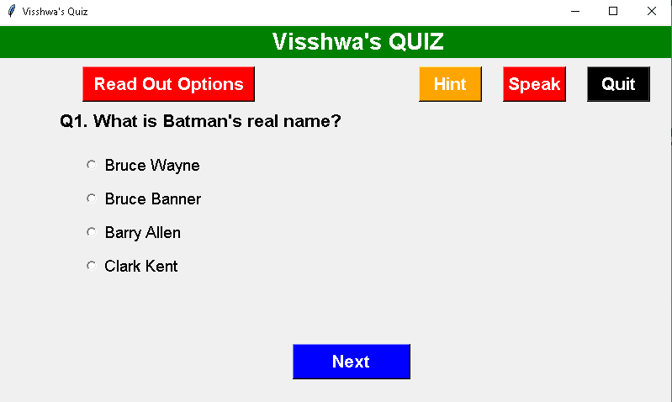
About App..
App’s Main Menu
App’s Introduction
This is a quiz app that offers a variety of features from Hints to your own assistant that reads out the questions for you.

Slide 7
How do I use the App?

Slide 8

Option Name: Hint
Screenshot/ Pic of each option/screen of the App
Steps to use the same
Any special considerations/ dependencies/risks while using the option

Slide 9

Option Name: Read out Options
Screenshot/ Pic of each option/screen of the App
Steps to use the same
Any special considerations/ dependencies/risks while using the option

Slide 10

Option Name: Speak
Screenshot/ Pic of each option/screen of the App
Steps to use the same
Any special considerations/ dependencies/risks while using the option

Slide 11

Option Name: Quit
Screenshot/ Pic of each option/screen of the App
Steps to use the same
After clicking this option the code will stop running and exit you from the interface.

Slide 12
Demo Video
https://drive.google.com/file/d/1Bywyyh7rtzFA4Vj7d9b7zCbIuZ5MdnAO/view

Slide 13
Toolkit Walkthrough
Conduct 1 minute quick walkthrough of App Development Toolkit Workbook and LinkedIn and Github launch of the App. Attach links here for quick access.

Slide 14
Contact Person
Please reach out to student name at student’s email address for any questions/ concerns/ suggestions on the App

Slide 15
Thank you!

